Slide 1


Leliebloem House then, now… and the future!
Beyond 2018

Slide 2

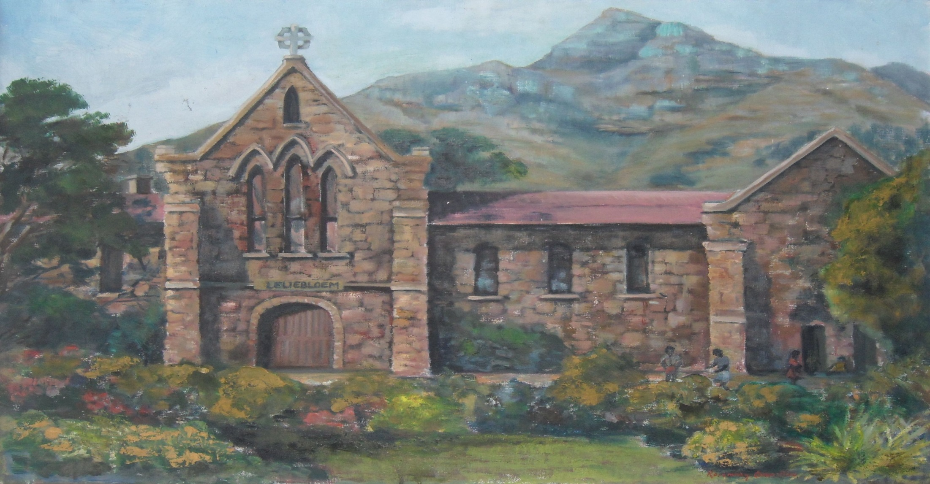
An artist impression of The Leliebloem House in Woodstock

Slide 3

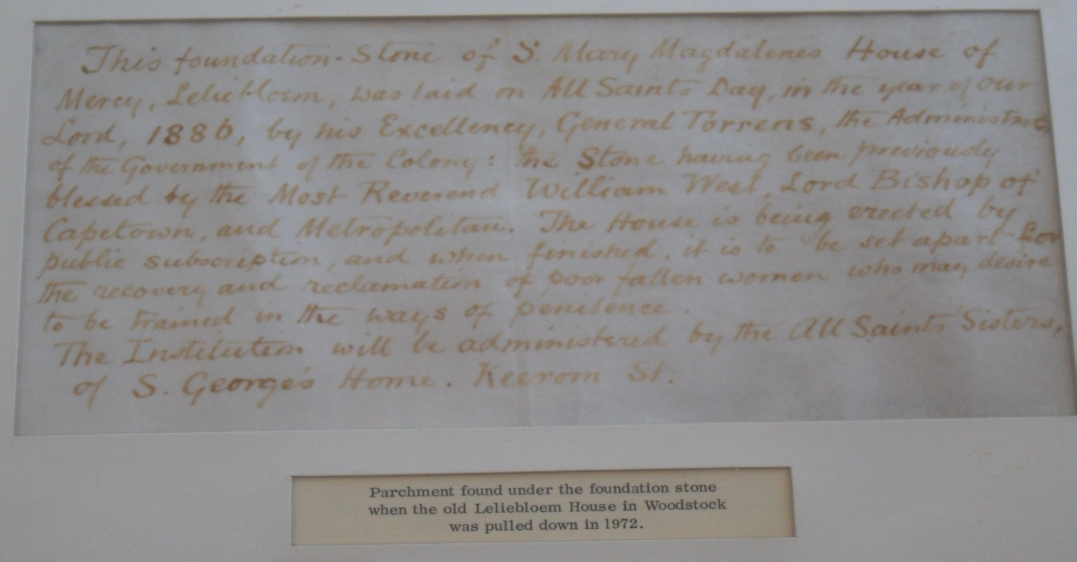
Evidence

Slide 4
Old logo

Slide 5
2010

Slide 6
History
Leliebloem House was founded as a House of Mercy in 1868.
Today, it is a registered, NPO, a residential Child and Youth Care Centre for 60 children from troubled families.
Providing services to children in difficult circumstances and in need of specialist care and intervention, high-risk environments where very poor and negative socio-economic conditions prevail.

Slide 7

TRAINING
FOSTERING/
HOSTING
Sherwood
Roslyn
RESIDENTIAL
CARE
Annandale
VOLUNTEERS
Albion
DunRobin
Fernhill
THERAPEUTIC
PROGRAM
Community
OUTREACH
and
Isibindi
Grabouw
FAMILY
REUNIFICATION
Program
Specialized
Behaviour
Management
Program
ADOLESCENT
DEVELOPMENT PROGRAM
AFTERCARE SERVICES

Slide 8
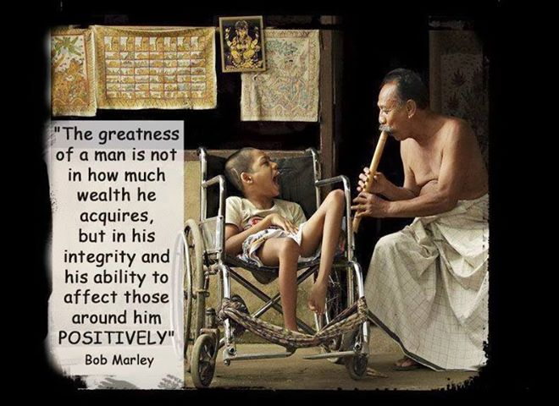
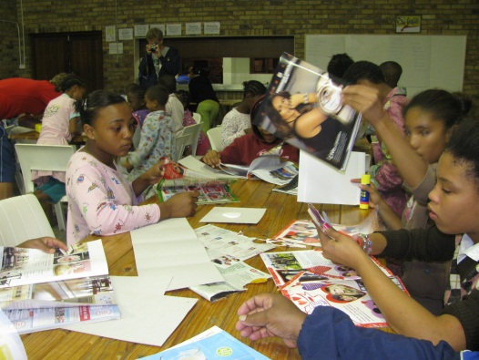
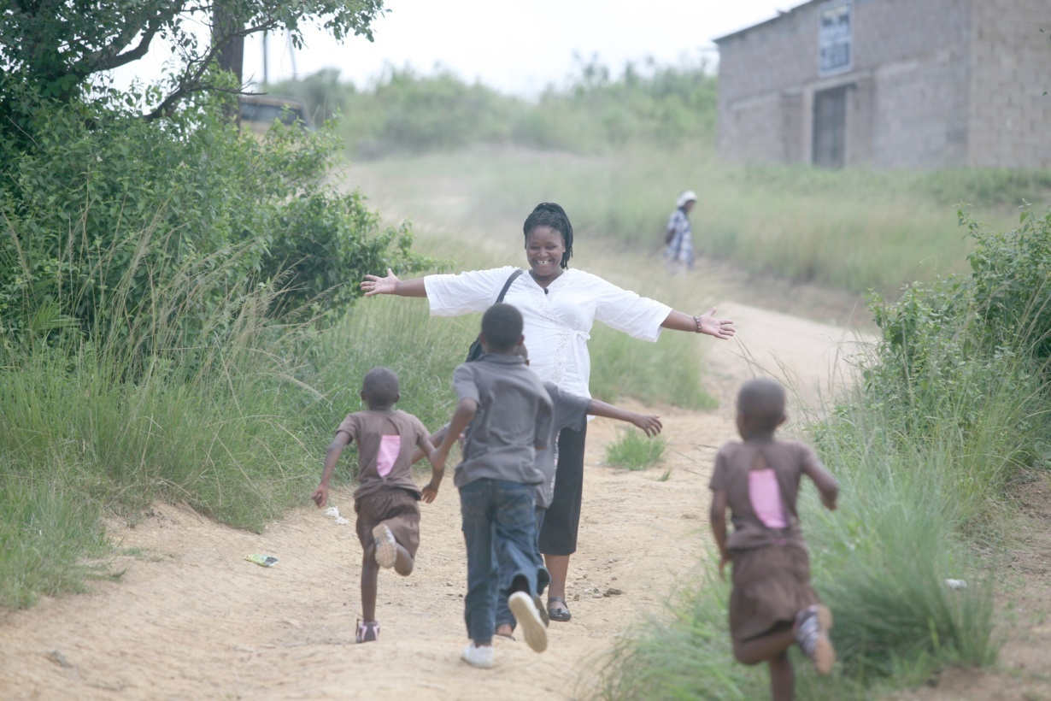

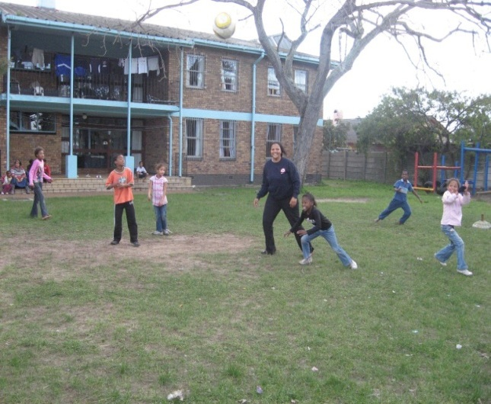
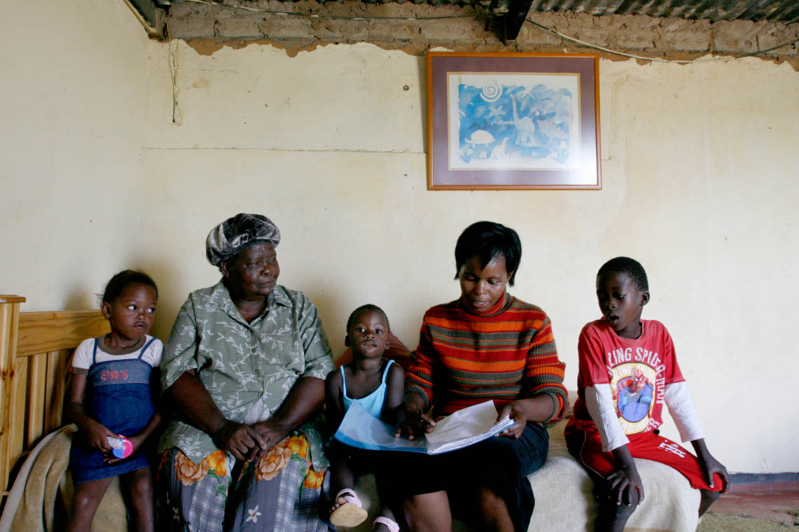
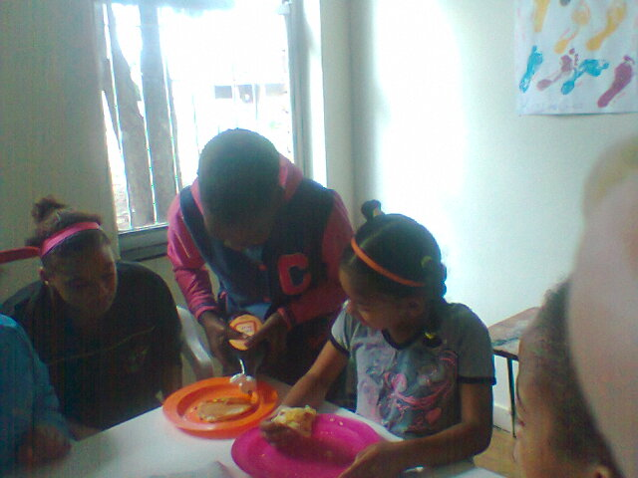
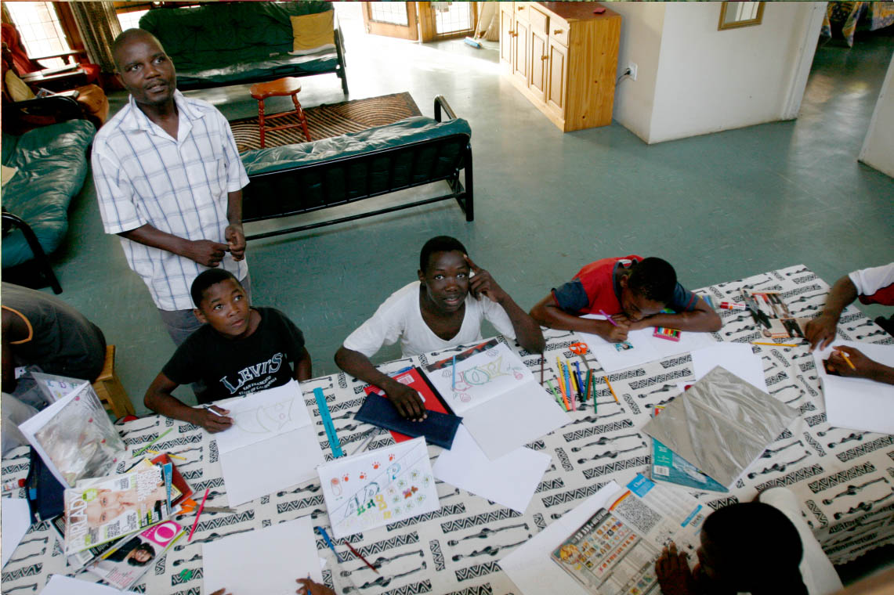
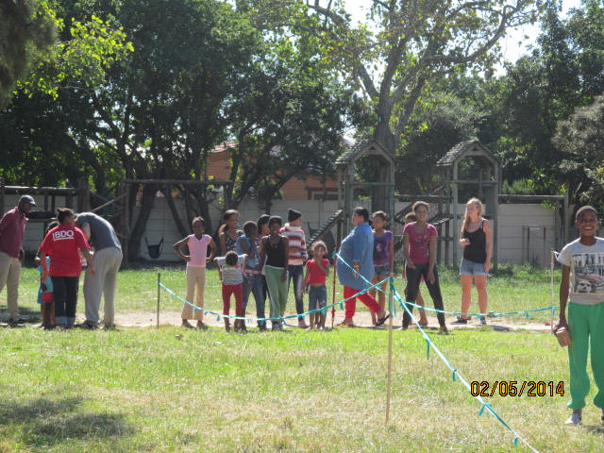
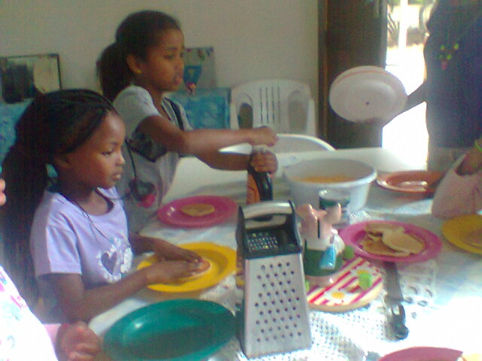

Slide 9

How can you help?
Adopt a Room
Become a Friend
Corporates – (introduce them to Leliebloem House)
Donate an item / ingredients/ food /educational stationary / school uniform
Donate money (pledge as little as R25 pm)
Or donate your reward card points
If you are interested, please text or email your details to our marketer to find out more:
021 – 697 4947 or 0827719233
fcornelius@leliebloem.org.za
marketer@leliebloem.org.za or administrator@leliebloem.org.za or funddeveloper@leliebloem.org.za or reception@leliebloem.org.za

Slide 10


Slide 11


Slide 12
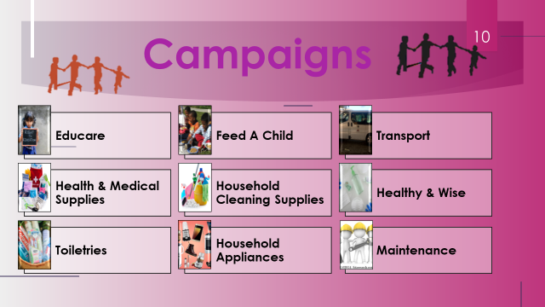

Slide 13
Major Project/Capex Project 2023
Repairs and Cleaning of Roofs
Recreational Hall Upgrade
Solar geysers
Repair Roofing all 3 units (cleaning, etc. these are asbestos sheets)
Windows repairs and replace
General maintenance (paint, repairs etc.)
Ceiling repairs (incl. paint)
Flooring
Lights in hall, toilets, stage
Stage curtains
All doors to be fixed
Windows
Projector
Toilets repairs
Shelving for kitchen

Slide 14
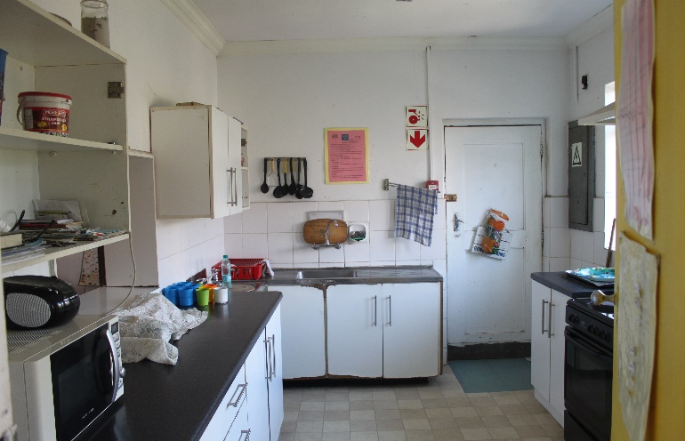
ADOPT A COTTAGE CAMPAIGN
Kitchen Upgrade
Replace/repair water pipes, drainpipes etc.
kitchen cupboards (fixing, etc.)
Doors replace/repairs, handles etc.
Stoves replace/repairs
Paint
Refurbish flooring
Windows replace/refurbish)
Curtaining or blinds
Pots, pans, utensils

Slide 15
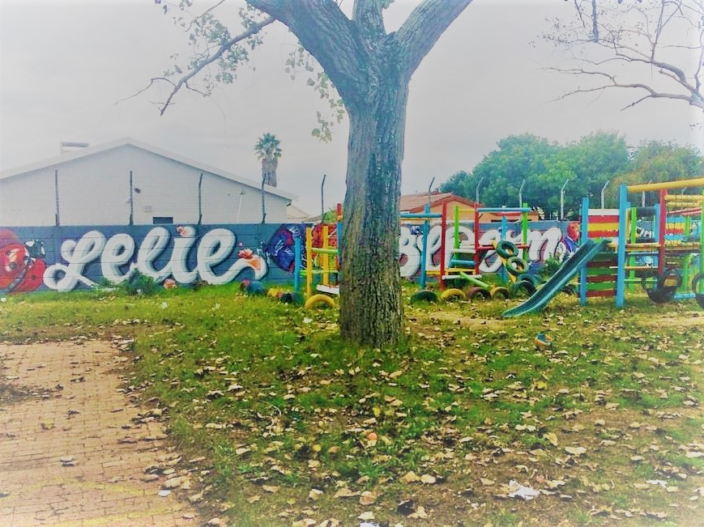
Needs List
Banking Details Name: Leliebloem House
Bank: Standard Bank
Account: 072 785 519
Branch: 025 909 (Vangate)
Swift Code: SBZA-ZA-JJ REF: (Cause) Name & Contact Number
Send POP to finance@leliebloem.org.za
Tax & BEE Benefits: A Section 18A Tax Certificate will be issued for the donated amount. South African companies will also receive points towards their B-BBEE status, as we hold a Level 1 Certificate and our beneficiaries are 100% black according to the B-BBEE Codes of Good Practice 2007.

Slide 16
Closing
“…if enough people were touched and imbued by the spirit of caring, it would in time change the whole landscape of how children are treated in this country.” Nelson Mandela
We are mindful of the fact that there could be a lot more done in supporting Social Service Professionals to render quality programmes in our communities in our country.
“If we don’t start, its certain we can’t arrive”
Zig Ziglar

Slide 17
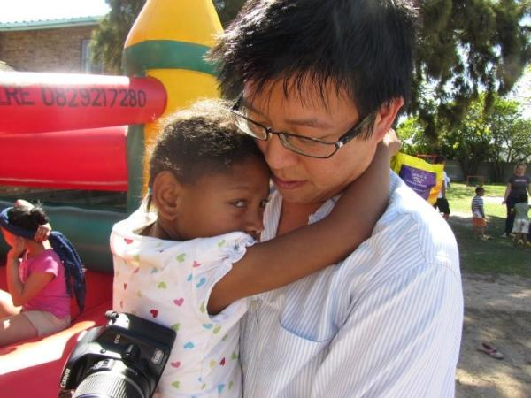
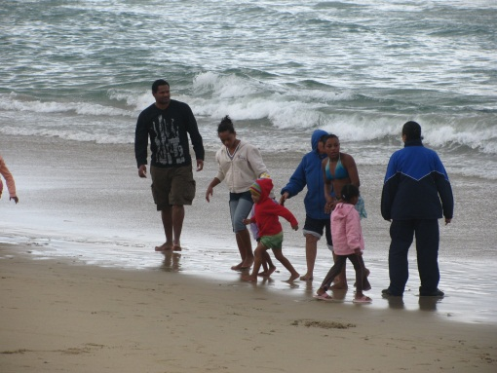
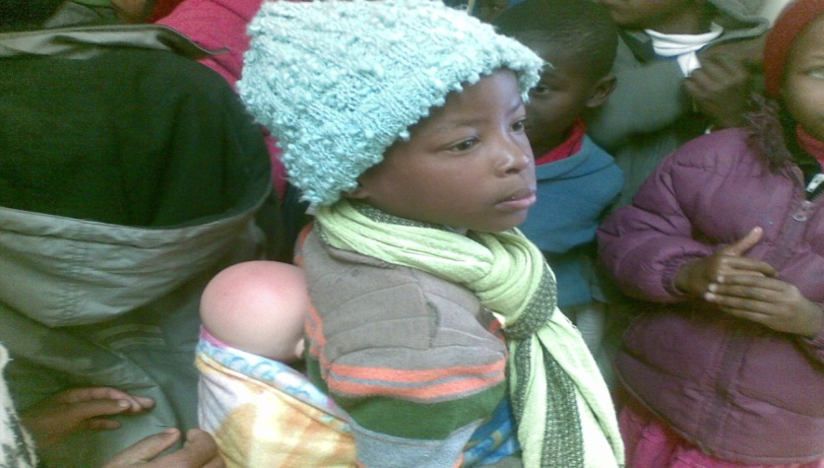
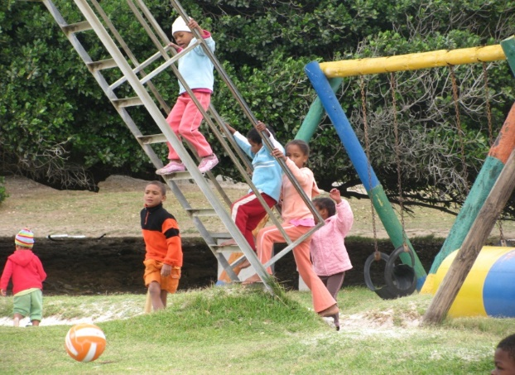
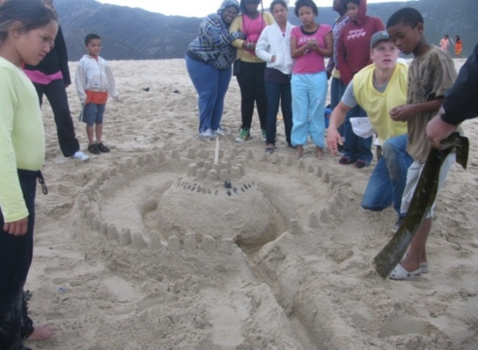
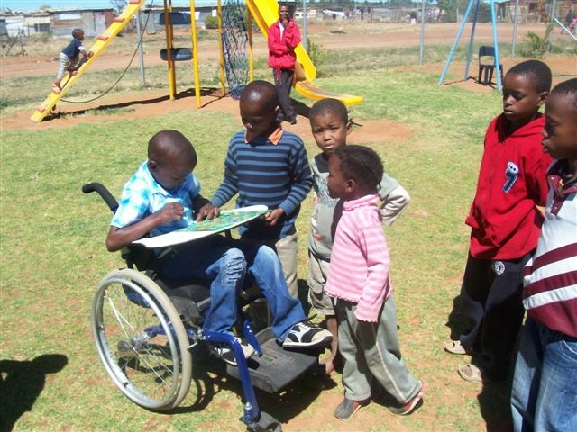


Belonging, belonging, belonging!
“Every child needs someone who is mad about him/her!”

Slide 18
We trust we have shed some light on our programs and that you can take something back with you.
Thank you for the opportunity.
Francisco Cornelius and the
Leliebloem House TEAM.
0827719233 or 021-6974947
fcornelius@leliebloem.org.za

